Slide 1


Masters Thesis Presentation
AUTOMATIC CONSTRUCTION OF HASHTAGS HIERARCHIES
By Debotosh Dey
Supervised by:
Dr. Antonio Moreno
UNIVERSITAT
ROVIRA I VIRGILI
Tarragona, June 2015

Slide 2
Objectives
Analyze and report the current state of the art on the analysis of tweets.
Obtain a data set of tweets.
Develop, implement and test new mechanisms of automatic hashtag hierarchy construction.
  Use of co-occurrence frequency vs. use of semantic measures.

Slide 3
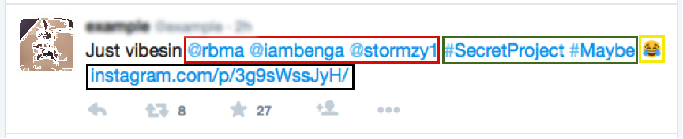
What is Twitter
Twitter is an online social networking service.
Each tweets is up to 140 characters.
  text
  links
  user mentions
  symbols emoticons
  hashtags

Slide 4
Scope
In general, tweets are usually ungrammatical.
Hashtags provide Twitter with a mechanism to semi-structure its content.
Hashtags may be used to categorize sets of tweets.
Motivate the need for systems that can aggregate and categorize all its content.
Examples:
  Large companies.
  Governments.

Slide 5
Why it is difficult ?
Hashtags are unstructured.
Tweets are very terse, often lacking sufficient context to categorize them.
Retrieval and classification methods have some basic problems
  Synonymy
  Polysemy

Slide 6
State of the Art
The three basic kinds of techniques that have been proposed to detect the main topics of interest within a set of messages exchanged in a social network.
  Probabilistic models.
  Document-pivot approaches.
  Feature-pivot methods.

Slide 7
Methodology
Clustering: this stage aims to group all the similar hashtags in clusters of related terms in order to detect topics of interest.
Topic selection: general discussion about the detection of the most relevant classes.

Slide 8
Some basic concepts and tools
Twitter
Knowledge repositories
  WordNet
  Ontology-based semantic similarity
Techniques
  Word-breaking
  Clustering
  Inter-class Homogeneity

Slide 9
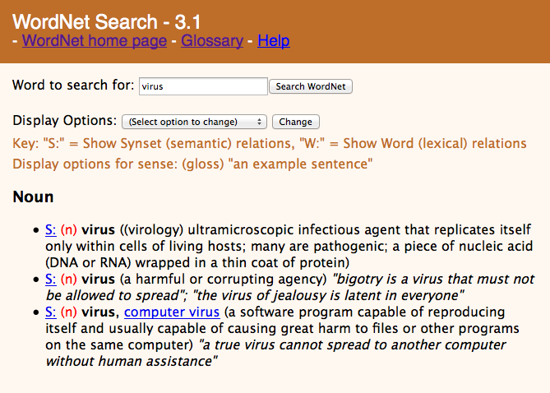
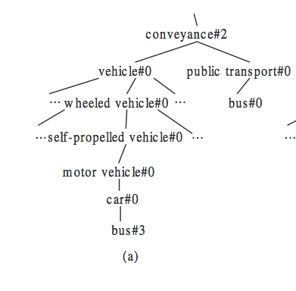
WordNet
WordNet is the most commonly used online lexical and semantic repository for the English language.
WordNet includes the main lexical categories (nouns, verbs, adjectives and adverbs) but ignore prepositions, determiners and other kinds of words.

Slide 10
Ontology-based semantic similarity
The science that aims to estimate the alikeness between words or concepts by evaluating their semantics.
To calculating the semantic similarity between words we have used the Wu and Palmer distance function.

Slide 11
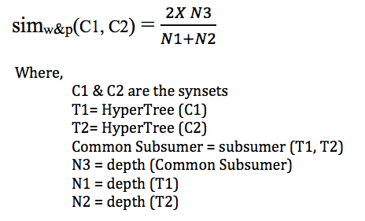
Wu and Palmer distance function

Slide 12
Word-breaking
If a hashtags or a word does not match with a WordNet entry, the word-breaking technique is applied.
It checks the matches between the subsequence of the hashtags and WordNet entries.
If a match is found, the subsequence is stored.
        iPhone6 -> Phone , hone, one, on
        SmartPhone -> Smart, Phone, mart, art, hone, one

Slide 13
Word-breaking
Two(if possible) large non-overlapping sub-sequence are taken.
    iPhone6 -> Phone
    SmartPhone -> Smart, Phone
In English it is usual that the words on the left are adjectives or terms that denote a specialization of the main noun, located on the right. Therefore, this procedure finds the most general specialization present in WordNet.
Thus when we analyze the data, we will consider “iPhone6” as “Phone”.

Slide 14
Clustering
Clustering is the task of grouping a set of objects in such a way that objects in the same group (called a cluster) are more similar to each other than to those in other groups.
we have chosen the hierarchical clustering method (with complete linkage) to classify the hashtags contained in a set of tweets
Complete linkage calculates the distance between two clusters as the maximum distance between a pair of objects.

Slide 15
Inter-class Homogeneity
Inter-class Homogeneity is a concept related to the degree of similarity between elements in the same cluster or the measurement of the degree of homogeneity among population elements within the sampling clusters.

Slide 16
Methodology : Clustering
Syntactic hashtag clustering
Semantic hashtag clustering

Slide 17

Syntactic hashtag clustering
The main consideration of the similarity matrix is that the more frequently two hashtags appear in one tweets, the more related they are supposed to be.
∀i ∈[1,n] ∀j ∈[1,n], c_{ij} = 𝑁𝑜𝑟𝑚a𝑙𝑖𝑧𝑒𝑑 (i,j)

Slide 18
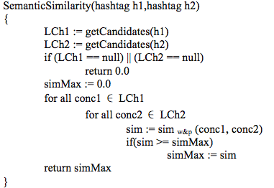
Semantic hashtag clustering
Semantic similarity is calculated using the Wu & Palmer on WorNet.
∀i ∈[1,n] ∀j ∈[1,n], sij = SemanticSimilarity (hi,hj)

Slide 19
Topic selection
Three basic approaches:
  Bottom-up approach.
  Top-down approach.
  Dendogram approach.
Filtering has two threshold values:
  Minimum number of elements.
  Minimum inter-class homogeneity.

Slide 20
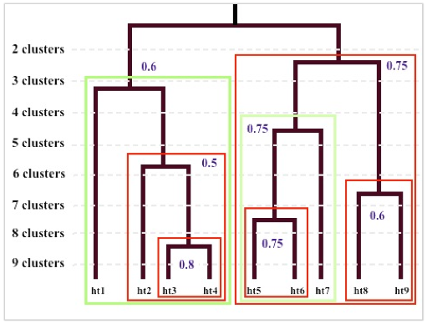
  Bottom-up approach

Slide 21
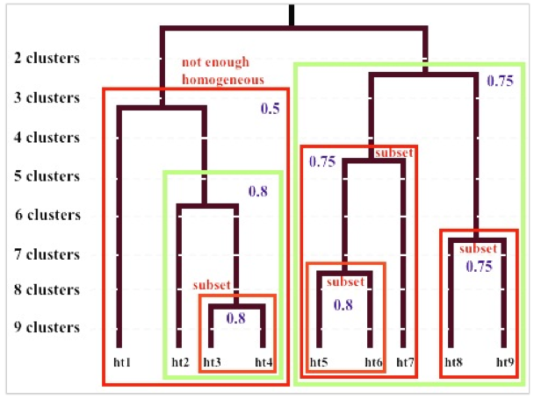
  Top-down approach

Slide 22
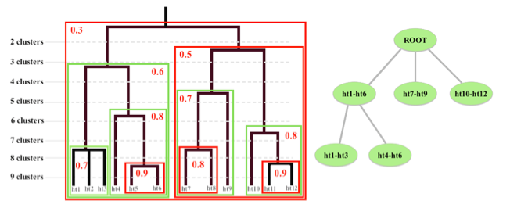
  Dendogram approach

Slide 23
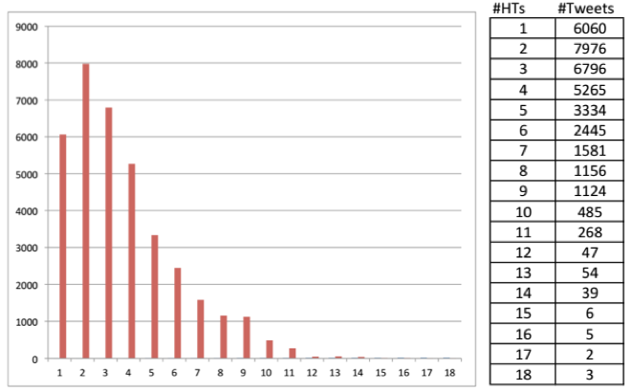
Case study :The Dataset
1000 tweets contained the hashtag #sensor
Then for each hashtags (found in those 1000 tweets) we again extract, if possible, 100 tweets.
36646 hashtagged tweets with 19226 unique hashtags were collected.

Slide 24
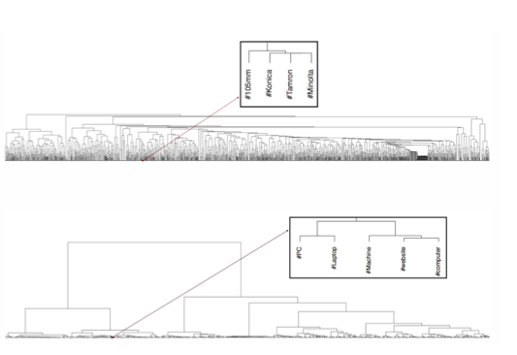
Analysis of the set of tweets: Cluster
Clustering based on Co-occurrence frequency
Clustering based on Semantic similarity

Slide 25
Threshold mHT (minimum number of hashtags in one cluster):
  For co-occurrence: values ranging from 5 to 45 in interval of 5.
  For semantic: values ranging from 5 to 50 in interval of 5.
Threshold mHG (minimum inter-class homogeneity in one cluster):
  For co-occurrence: values ranging from 0.1 to 0.65 in interval of 0.05.
  For semantic: values ranging from 0.3 to 0.95 in interval of 0.05

Slide 26
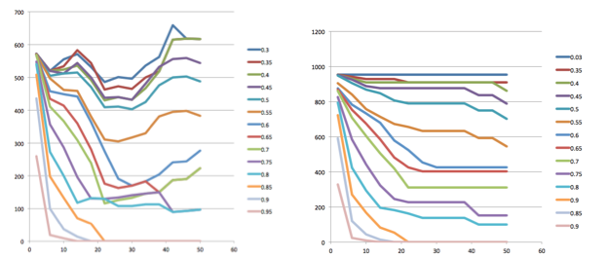
Analysis of the set of tweets
Analysis 1: Total number of hashtags selected by the system
Total hashtags found for the Topic selection Bottom-Up (left) Top-Down (right) analysis
Based on semantic similarity clustering

Slide 27
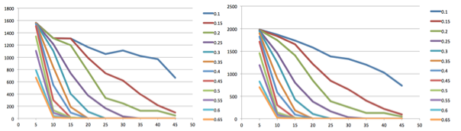
Analysis of the set of tweets
Analysis 1: Total number of hashtags selected by the system
Total hashtags found for the Topic selection Bottom-Up (left) Top-Down (right) analysis
based on co-occurrence clustering

Slide 28
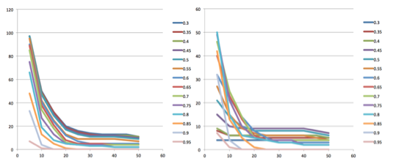
Analysis of the set of tweets
Analysis 2: Total number of clusters selected by the system
Total clusters found for the Topic selection Bottom-Up (left) Top-Down (right) analysis
based on semantic similarity clustering

Slide 29
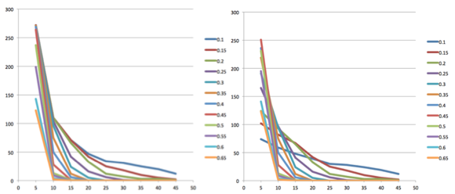
Analysis of the set of tweets
Analysis 2: Total number of clusters selected by the system
Total clusters found for the Topic selection Bottom-Up (left) Top-Down (right) analysis
based on co-occurrence clustering

Slide 30
Observations
The clustering based on semantic similarity can extract more hashtags and clusters when we demand high homogeneity and high number of hashtags.

Slide 31
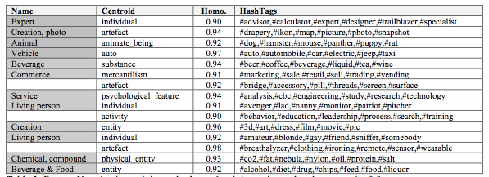
Result : Semantic Clustering (Bottom Up)
Minimum hashtags 6, minimum inter-class homogeneity 0.9

Slide 32
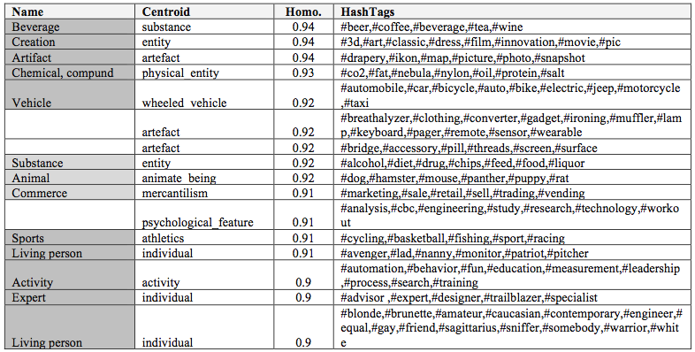
Result: Semantic Clustering (Top-Down)
Minimum hashtags 6, minimum inter-class homogeneity 0.9

Slide 33
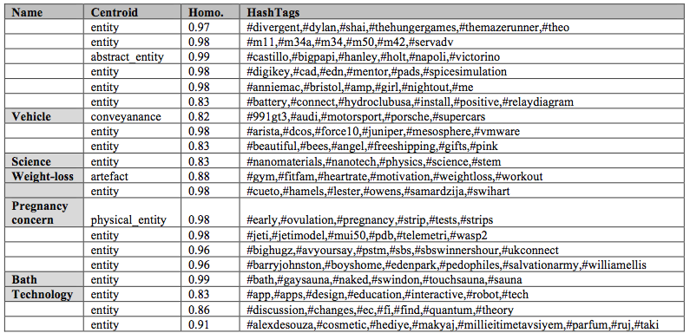
Result : Syntactic Clustering (Bottom-Up)
Minimum hashtags 6, minimum inter-class homogeneity 0.8

Slide 34
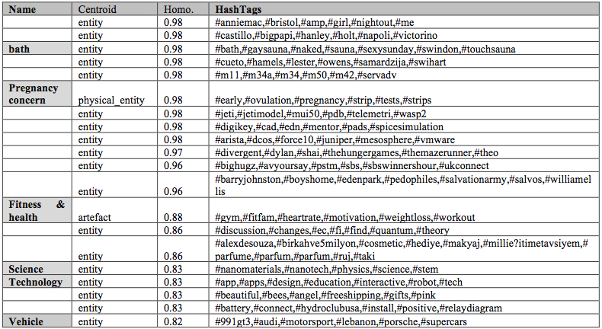
Result : Syntactic Clustering (Top-Down)
Minimum hashtags 6, minimum inter-class homogeneity 0.8

Slide 35
Observations
For semantic clustering
    Most of classes a general name can be set.
    The semantic centroid generated by the system is good.
    most precise clustering : higher “minimum homogeneity” and lower “minimum number of hashtags”.
    System can generate a general class with a large number of hashtags.
    For some clusters it is hard to set a name manually, but the system can find a general semantic centroid.
For co-occurrence clustering
  For few classes a general name can be set.
  the semantic centroid generated by the system is not good
  System not able to generate a general class
  with a large number of hashtags.

Slide 36
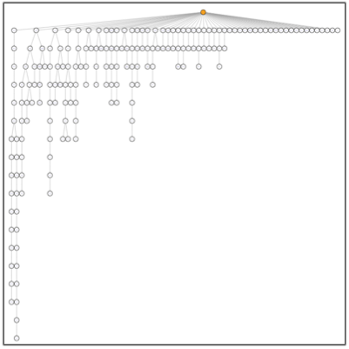
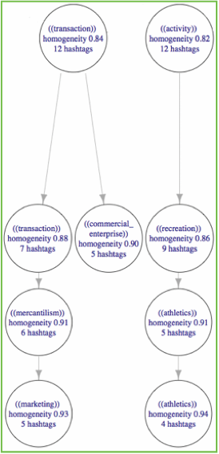
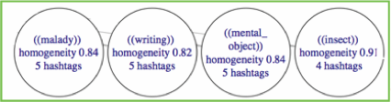
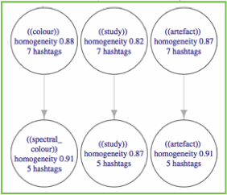
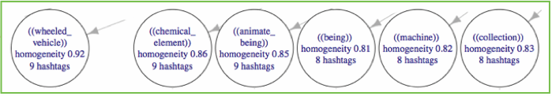
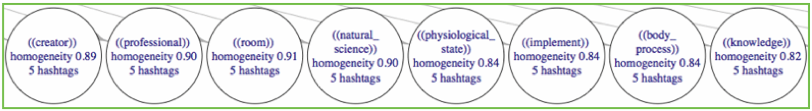
Dendogram Result

Slide 37
Observations
Each branch of the tree the semantic centroids go from general concepts to more specific ones.
There are some long branches (e.g. entity, individual) that are not very illustrative.

Slide 38
Conclusion
A hierarchical clustering is applied to group all the similar hashtags.
For the syntactic clustering: the co- occurrence matrix is normalized to calculate the similarity matrix.
For the semantic hashtag clustering:
  Wordnet
  WordBreaking
  Words not found in WordNet are removed
  Similarity matrix is calculated using the application of
  the Wu-Palmer distance on WordNet and co-occurrence frequency.

Slide 39
Conclusion
Bottom-up selection of clusters:
Aims to find the most specific classes that fulfill the selection criteria.
Top-down selection of clusters:
Aims to find the most general classes that fulfill the selection criteria.
Dendogram analysis of clusters:
Aims to obtain a hierarchy of clusters that fulfill the selection criteria.

Slide 40
Conclusion
Regarding the case study
  Number of hashtags and number of cluster: the clustering based on semantic similarity is better.
  Topic selection approaches: the clustering based on semantic similarity is better.
  Automatic construction of hashtags hierarchy based on semantic analysis produces a better result.

Slide 41
Future work
Apply "stemming" techniques.
Concepts using other knowledge structures. e.g. YAGO
  Wikipedia (e.g., categories, redirects, infoboxes)
  WordNet (e.g., synsets, hyponymy)
  GeoNames
The specific treatment of polysemic hashtags.

Slide 42
THANK YOU……

